Slide 1





BATHO HEALTHCARE
Your Health Our Responsibility
Home
About Us
Contact
Sign Up
Login
We Know Health Is Wealth
That’s Why We Obligated Our Selves To Keep You Alife
More Info
Batho Healthcare Info
Bathohealthcare@gmail.com
www.bathohealthcare.ac.za
+31 156 7789
Emergency Contact: +51 456 7786
@All Right Reserved by MMNK DEVELOPERS

Slide 2



BATHO HEALTHCARE
Your Health is our Responsibility
Back
As employees of Batho Hospital , we pledge to provide compassionate care, strive for excellence act with integrity , respect diversity, ensure safety and support our community
Our Core Values
Compassionate Care
Excellence in care
We treat every patient with kindness and respect, focusing on their individual and well-being
We deliver top quality medical care by staying up to date with practices and technology
Batho Healthcare Info
Bathohealthcare@gmail.com
www.bathohealthcare.ac.za
+31 156 7789
Emergency Contact: +51 456 7786
@All Right Reserved by MMNK DEVELOPERS

Slide 3
Sign Up
* All fields should be filled
Email Address
*
Sign Up
Already have an account? Login
Confirm Email Address
*
Password
*
Confirm Password
*
Batho Healthcare Info
Bathohealthcare@gmail.com
www.bathohealthcare.ac.za
+31 156 7789
Emergency Contact: +51 456 7786
@All Right Reserved by MMNK DEVELOPERS

Slide 4
Sign Up
* All field should be filled
Please enter email
*
Sign Up
Already have an account? Login
Please confirm email
*
Please enter Password
*
Please confirm Password
*
Batho Healthcare Info
Bathohealthcare@gmail.com
www.bathohealthcare.ac.za
+31 156 7789
Emergency Contact: +51 456 7786
@All Right Reserved by MMNK DEVELOPERS

Slide 5
Sign Up
* All field should be filled
ntshuxekoyvonne@gmail.com
*
Sign Up
Already have an account? Login
ntshuxekoyvonne@gmail.com
*
Yvonne@2
*
Yvonne@2
*
Batho Healthcare Info
Bathohealthcare@gmail.com
www.bathohealthcare.ac.za
+31 156 7789
Emergency Contact: +51 456 7786
@All Right Reserved by MMNK DEVELOPERS

Slide 6



LOGIN
Username
Password
Forgot password?
Login
Batho Healthcare Info
Bathohealthcare@gmail.com
www.bathohealthcare.ac.za
+31 156 7789
Emergency Contact: +51 456 7786
@All Right Reserved by MMNK DEVELOPERS

Slide 7

LOGIN
Username
ntshuxekoyvonne@gmail.com
Password
********
Show
Forgot password?
Login
Batho Healthcare Info
Bathohealthcare@gmail.com
www.bathohealthcare.ac.za
+31 156 7789
Emergency Contact: +51 456 7786
@All Right Reserved by MMNK DEVELOPERS

Slide 8
LOGIN
Username
ntshuxekoyvonne@gmail.com
The password must be in the following format
*
Start with Uppercase
Maximum 8 characters
No special characters
Password
********
*
Show
Forgot password?
Login
Invalid login credentials
Batho Healthcare Info
Bathohealthcare@gmail.com
www.bathohealthcare.ac.za
+31 156 7789
Emergency Contact: +51 456 7786
@All Right Reserved by MMNK DEVELOPERS

Slide 9
LOGIN
Username
ntshuxekoyvonne@gmail.com
The password must be in the following format
*
Start with Uppercase
Maximum 8 characters
No special characters
Password
/
Yvonne@2
*
Hide
Forgot password?
Login
Invalid login credentials
Batho Healthcare Info
Bathohealthcare@gmail.com
www.bathohealthcare.ac.za
+31 156 7789
Emergency Contact: +51 456 7786
@All Right Reserved by MMNK DEVELOPERS

Slide 10
LOGIN
Username
ntshuxekoyvonne@gmail.com
The password must be in the following format
*
Start with Uppercase
Maximum 8 characters
No special characters
Password
/
Yvonne22
*
Hide
Forgot password?
Login
Invalid login credentials
Batho Healthcare Info
Bathohealthcare@gmail.com
www.bathohealthcare.ac.za
+31 156 7789
Emergency Contact: +51 456 7786
@All Right Reserved by MMNK DEVELOPERS

Slide 11
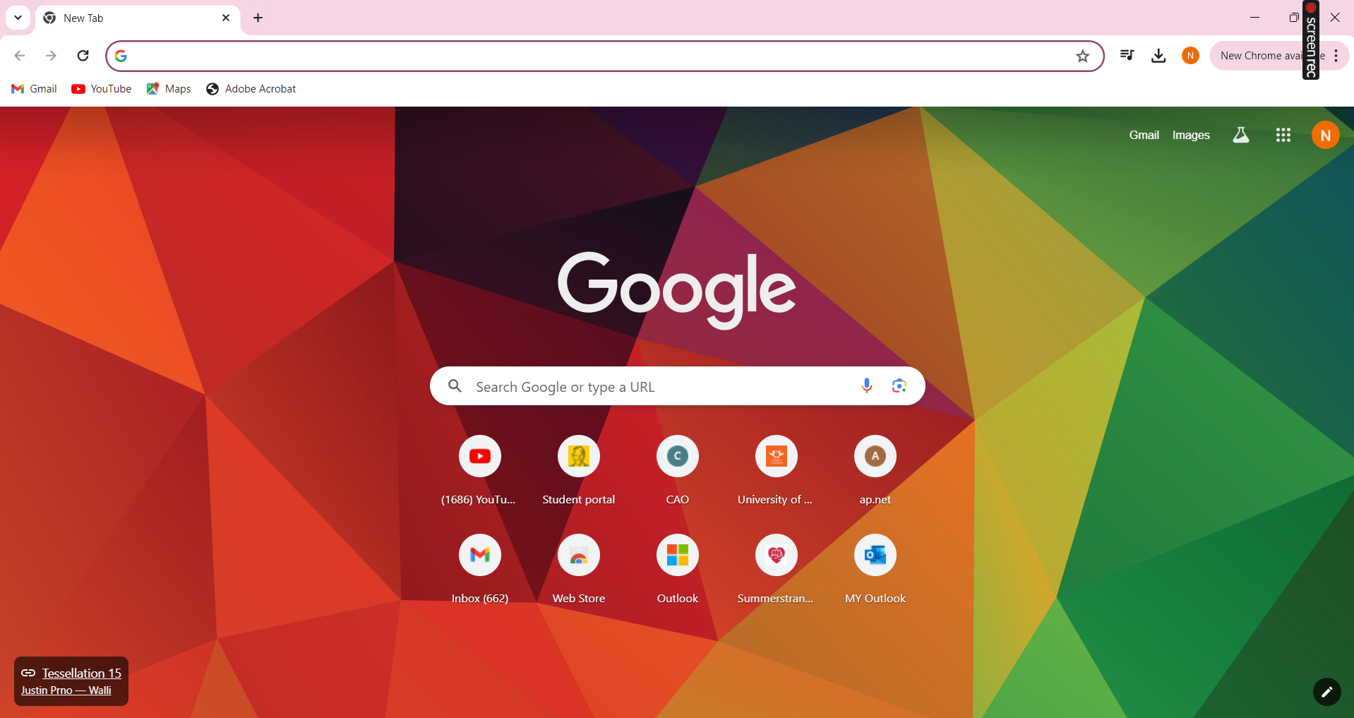








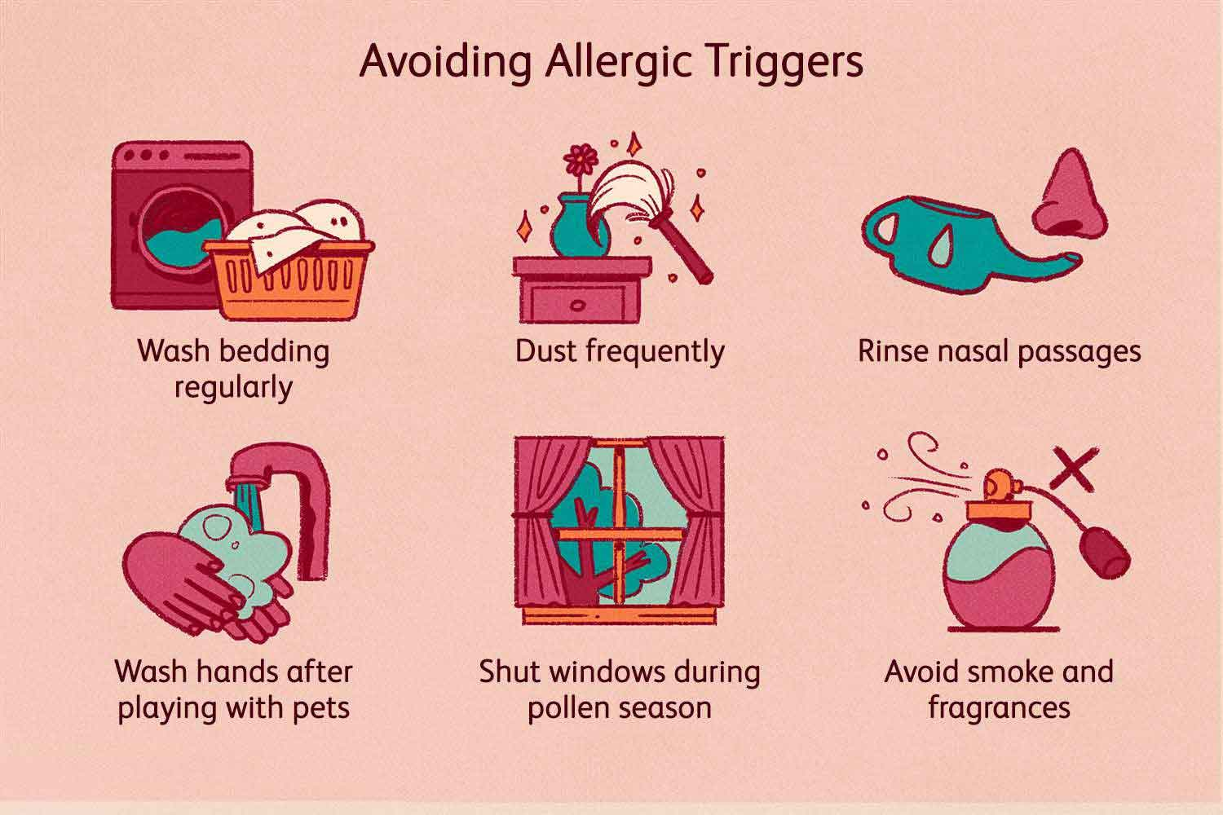

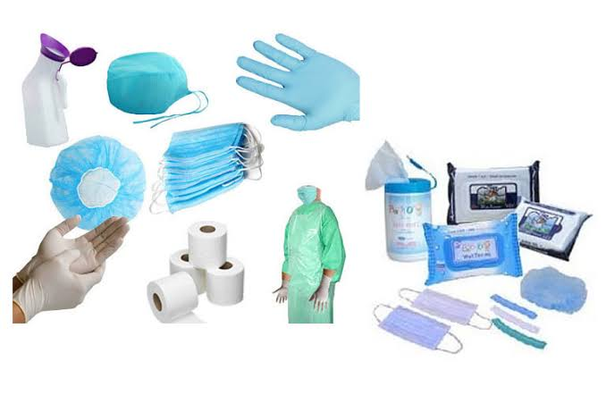


Batho Healthcare
Search..
Welcome
Admin N Yvonne
Home Dashboard My Schedule
Manage Employees
Manage Beds
Manage Conditions
Manage Allergies
Manage Hospital
Manage Consumable
Manage Medication
Batho Healthcare Info
Bathohealthcare@gmail.com
www.bathohealthcare.ac.za
+31 156 7789
Emergency Contact: +51 456 7786
@All Right Reserved by MMNK DEVELOPERS

Slide 12

Batho Healthcare
Search..
Welcome
Admin N Yvonne
MANAGING EMPLOYEES
First Name:
Save
Middle Name:
Last Name:
Identity No:
Gender:
Date of Birth:
Physical Address:
Email Address:
Contact No:
Specialisation:

Slide 13


Batho Healthcare
Search..
Welcome
Admin N Yvonne
DISPLAY EMPLOYEES
Print
Search
Employee Name | Identity No | Date Of Birth | Gender | Physical Address | Email | Contact | Specialisation | Status
John Macathy | 911212 | 1991-12-12 | Male | Port Elizabeth | j@gmail.com | 071 111 1455 | Doctor | Active
Batho Healthcare Info
Bathohealthcare@gmail.com
www.bathohealthcare.ac.za
+31 156 7789
Emergency Contact: +51 456 7786
@All Right Reserved by MMNK DEVELOPERS

Slide 14
Batho Healthcare
Search..
Welcome
Admin N Yvonne
Do you want to update employee’s status
DISPLAY EMPLOYEES
Yes
No
Print
Search
Employee Name | Identity No | Date Of Birth | Gender | Physical Address | Email | Contact | Specialisation | Status
John Macathy | 911212 | 1991-12-12 | Male | Port Elizabeth | j@gmail.com | 071 111 1455 | Doctor | InActive
Batho Healthcare Info
Bathohealthcare@gmail.com
www.bathohealthcare.ac.za
+31 156 7789
Emergency Contact: +51 456 7786
@All Right Reserved by MMNK DEVELOPERS

Slide 15



Batho Healthcare
Search..
Welcome
Admin N Yvonne
MANAGE BEDS
Occupied Beds
Free Beds
Need of Maintenance
11
10
5
PatientID | Room No | Ward No | Bed No | Patient Status
001 | C12 | 01 | 003 | Admitted
023 | C12 | 01 | 004 | Discharged
Batho Healthcare Info
Bathohealthcare@gmail.com
www.bathohealthcare.ac.za
+31 156 7789
Emergency Contact: +51 456 7786
@All Right Reserved by MMNK DEVELOPERS

Slide 16


Batho Healthcare
Search..
Welcome
Admin N Yvonne
ADMITTED PATIENT DETAILS
BATHO HEALTHCARE
Your Health Our Responsibility
Patient No
001
Ward C12 01
Names:
Rosemary
Last Name:
Dube
Reason of Admission:
Diabetes Mellites
Date Of Admission :
11 March 2024
Possible discharge date:
N/A
Referred Doctor:
John McCarthy
Transfer Patient:
--Select Ward--
--Select Bed--
Transfer
Batho Healthcare Info
Bathohealthcare@gmail.com
www.bathohealthcare.ac.za
+31 156 7789
Emergency Contact: +51 456 7786
@All Right Reserved by MMNK DEVELOPERS

Slide 17

Batho Healthcare
Search..
Welcome
Admin N Yvonne
MANAGE HOSPITAL
Hospital Name
Hospital Slogan
Hospital Address
Hospital Contact Details
Hospital logo
Upload a logo
Only PDF is allowed
UPDATE
Batho Healthcare Info
Bathohealthcare@gmail.com
www.bathohealthcare.ac.za
+31 156 7789
Emergency Contact: +51 456 7786
@All Right Reserved by MMNK DEVELOPERS

Slide 18
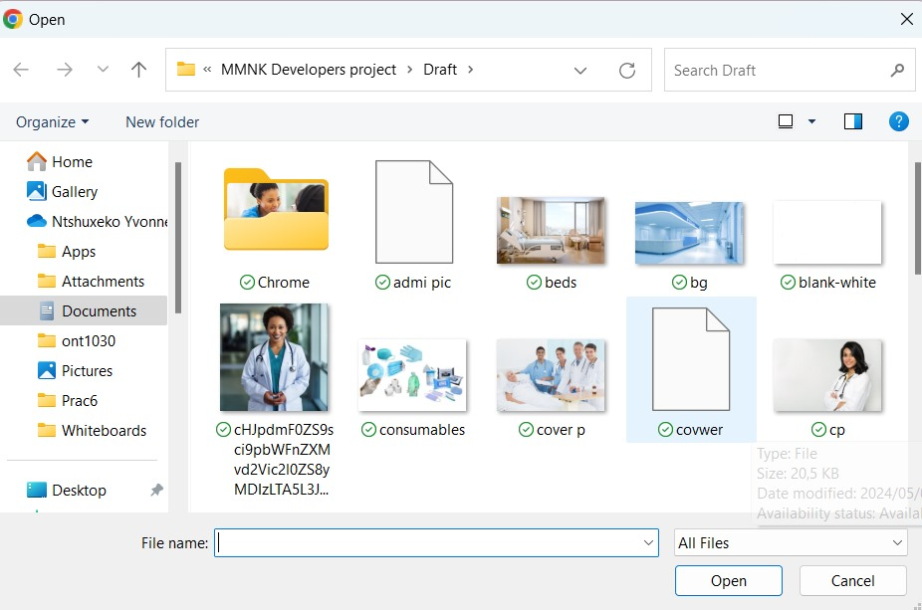
Batho Healthcare
Search..
Welcome
Admin N Yvonne
MANAGE HOSPITAL
Hospital Name
Hospital Slogan
Hospital Address
Hospital Contact Details
Hospital logo
Upload a logo
Only PDF is allowed
UPDATE
Batho Healthcare Info
Bathohealthcare@gmail.com
www.bathohealthcare.ac.za
+31 156 7789
Emergency Contact: +51 456 7786
@All Right Reserved by MMNK DEVELOPERS

Slide 19

Batho Healthcare
Search..
Welcome
Admin N Yvonne
MANAGE CONDITIONS
Add
Update
Acute Condition | Chronic Disease | Infectious Diseases | End-of-life | Mental Health | Surgical Condition | Maternal and Neonal Condition | Chronic Pain Management
Heart Attach | Diabetes Mellitus | Influenza | Appendicitis | Depression | Pregnancy Compilation | Fibromyalgia | Pilliative Care
Batho Healthcare Info
Bathohealthcare@gmail.com
www.bathohealthcare.ac.za
+31 156 7789
Emergency Contact: +51 456 7786
@All Right Reserved by MMNK DEVELOPERS

Slide 20
Batho Healthcare
Search..
Welcome
Admin N Yvonne
MANAGE ALLERGIES
Batho Healthcare Info
Bathohealthcare@gmail.com
www.bathohealthcare.ac.za
+31 156 7789
Emergency Contact: +51 456 7786
@All Right Reserved by MMNK DEVELOPERS

Slide 21
Batho Healthcare
Search..
Welcome
Admin N Yvonne
MANAGE MEDICATION
Analgesics(Pain Relievers) | Antibiotics | Antihistamine | Antacids | Antidepressants | Antidiabetic Medications | Anticoagulants
Aspirin | Penicillin | Cetirizine | Calcium Carbonate | Cymbalta | Metformin | Heparin
Batho Healthcare Info
Bathohealthcare@gmail.com
www.bathohealthcare.ac.za
+31 156 7789
Emergency Contact: +51 456 7786
@All Right Reserved by MMNK DEVELOPERS

Slide 22
Batho Healthcare
Search..
Welcome
Admin N Yvonne
MANAGE CONSUMABLES
Consumable Name | Availability Status
Adhesive Bandages | Available
Sterile Gloves | Available
Syringes and Needles | Available
Alcohol Swabs | Available
Medical Type | Available
Disposable under pads | Available
Disposables Marks | Available
Disposables Gowns | Available
Disposable Caps and Shoe Covers | Available
Update
Batho Healthcare Info
Bathohealthcare@gmail.com
www.bathohealthcare.ac.za
+31 156 7789
Emergency Contact: +51 456 7786
@All Right Reserved by MMNK DEVELOPERS

Slide 23
Batho Healthcare
Search..
Welcome
Admin N Yvonne
DOCTOR REFFERAL
First Name
Last Name
Date of Birth
Gender
--Select --
Doctor Name
Contact No
Admission Date
Batho Healthcare Info
Bathohealthcare@gmail.com
www.bathohealthcare.ac.za
+31 156 7789
Emergency Contact: +51 456 7786
@All Right Reserved by MMNK DEVELOPERS

Slide 24

Batho Healthcare
Search..
Welcome
Admin N Yvonne
DOCTOR REFFERAL
First Name
Joseph
Last Name
Marry
Date of Birth
01 May 1996
Gender
Male
Doctor Name
Dr John Macathy
Contact No
(+27)76 888 9090
Admission Date
2 Dec 2024
Save
Display
Batho Healthcare Info
Bathohealthcare@gmail.com
www.bathohealthcare.ac.za
+31 156 7789
Emergency Contact: +51 456 7786
@All Right Reserved by MMNK DEVELOPERS

Slide 25
Batho Healthcare
Search..
Welcome
Admin N Yvonne
PATIENT REFFERAL
Patient Name | Date of Birth | Gender | Contact No | Doctor | Admission Date
Joseph Marry | 01 May 1996 | Male | 076 888 9090 | John Macathy | 02 Dec 2024
Batho Healthcare Info
Bathohealthcare@gmail.com
www.bathohealthcare.ac.za
+31 156 7789
Emergency Contact: +51 456 7786
@All Right Reserved by MMNK DEVELOPERS

Slide 26

Batho Healthcare
Search..
Welcome
Admin N Yvonne
CREATE PATIENT FOLDER
Personal Information
Contact Information
Title:
Mr
*
Phone No:
078 888 9090
*
(071-36-36-981
Names:
*
Email:
jm@gmail.com
*
Date of Birth:
01 May 1996
*
Address Details
Identity No:
Must be13 Digits
No characters
Address Line 1:
*
*
Address Line 2:
*
Marital Status:
Married
*
Suburb:
Summerstrand
*
Gender:
Male
*
City:
Port Elizabeth
*
Occupation:
Lawyer
*
Postal Code:
6001
*
Language:
*
Province:
Eastern Cape
*
Bed:
003DC
*
Next Of Kin
Bed Status:
Occupied
*
First Name:
Mandlovu
*
Allergies:
--Select--
*
Last Name:
Marry
*
Diabetes
*
Contact No:
Unable to submit Please fill out all
Chronic Conditions:
*
Relationship:
Wife
*
Do you smoke?:
Yes
No
*
Admission Status:
Admitted
*
Submit

Slide 27


Batho Healthcare
Welcome
Admin N Yvonne
Search..
CREATE PATIENT FOLDER
Personal Information
NEXT
Title:
Mr
*
Names:
*
Date of Birth:
01 May 1996
*
Identity No:
960501786
Must be13 Digits
No characters
Marital Status:
Married
Gender:
Male
*
Occupation:
Lawyer
*
Language:
Afrikaans
*
Batho Healthcare Info
Bathohealthcare@gmail.com
www.bathohealthcare.ac.za
+31 156 7789
Emergency Contact: +51 456 7786
@All Right Reserved by MMNK DEVELOPERS

Slide 28

Batho Healthcare
Search..
Welcome
Admin N Yvonne
NEXT
BACK
Address Details
Contact Information
Phone No:
078 888 9090
*
(071-38-38-963)
Address Line 1:
*
Address Line 2:
Email:
*
Stand no 56
*
jm@gmail.com
(name@gmail.com)
Suburb:
Summerstrand
*
City:
Port Elizabeth
*
Postal Code:
6001
*
Province:
Eastern Cape
*
Batho Healthcare Info
Bathohealthcare@gmail.com
www.bathohealthcare.ac.za
+31 156 7789
Emergency Contact: +51 456 7786
@All Right Reserved by MMNK DEVELOPERS

Slide 29
Batho Healthcare
Search..
Welcome
Admin N Yvonne
NEXT
BACK
Next Of Kin
First Name:
Mandlovu
*
Last Name:
Marry
*
*
Contact No:
(071-38-38-963)
*
Relationship:
Wife
*
Batho Healthcare Info
Bathohealthcare@gmail.com
www.bathohealthcare.ac.za
+31 156 7789
Emergency Contact: +51 456 7786
@All Right Reserved by MMNK DEVELOPERS

Slide 30
Batho Healthcare
Search..
Welcome
Admin N Yvonne
BACK
NEXT
Bed:
003DC
Bed Status:
Occupied
Allergies:
Peanuts
Chronic Conditions:
Diabetes
*
Yes
No
Unable to submit Please fill out all
Do you smoke?:
Admission Status:
Admitted
Submit
Batho Healthcare Info
Bathohealthcare@gmail.com
www.bathohealthcare.ac.za
+31 156 7789
Emergency Contact: +51 456 7786
@All Right Reserved by MMNK DEVELOPERS

Slide 31
Batho Healthcare
Search..
Welcome
Admin N Yvonne
VIEW PATIENT FILES
Search Patient File
Patient Name | ID No | Bed Allocation | Allergies | Chronic condition | Contact No | Emergency No | Admission Date | Admission Status
John Marry | 9605017863906 | 003DC | Allergic to peanuts | Diabetes Mellitus | 078 888 9090 | 078 167 8890 | 02 Dec 2024 | Admitted
Batho Healthcare Info
Bathohealthcare@gmail.com
www.bathohealthcare.ac.za
+31 156 7789
Emergency Contact: +51 456 7786
@All Right Reserved by MMNK DEVELOPERS

Slide 32
LOGIN
Username
ntshuxekoyvonne@gmail.com
Password
********
Show
Forgot password?
Login
Batho Healthcare Info
Bathohealthcare@gmail.com
www.bathohealthcare.ac.za
+31 156 7789
Emergency Contact: +51 456 7786
@All Right Reserved by MMNK DEVELOPERS

Slide 33
Batho Healthcare
Search..
Welcome
Nurse Kubheka
Home Dashboard My Schedule
Administer no-schedule Med
Contact Doctor
Record Patient’s Vitals
Treat Patient
View doctor’s Instruction
Record doctor’s Instruction
Batho Healthcare Info
Bathohealthcare@gmail.com
www.bathohealthcare.ac.za
+31 156 7789
Emergency Contact: +51 456 7786
@All Right Reserved by MMNK DEVELOPERS

Slide 34

Batho Healthcare
Search..
Welcome
Nurse Kubheka
Record Patient’s Vitals
Vitals Signs
Weight(kg):
Height (cm):
Systolic B.P:
Heart Rate:
Respiratory Rate:
Temperature:
Blood Sugar(f):
Oxygen Supplementation:
select
Vital Taken Date:
/ /
SAVE
Display
Batho Healthcare Info
Bathohealthcare@gmail.com
www.bathohealthcare.ac.za
+31 156 7789
Emergency Contact: +51 456 7786
@All Right Reserved by MMNK DEVELOPERS

Slide 35
Batho Healthcare
Welcome
Nurse Kubheka
View Patient Vitals
Patient ID | Patient Name | Date | Blood Pressures | Heat Rate | Blood Sugar | Temperature | Weight
 | John Marry | 02Dec 2024
Batho Healthcare Info
Bathohealthcare@gmail.com
www.bathohealthcare.ac.za
+31 156 7789
Emergency Contact: +51 456 7786
@All Right Reserved by MMNK DEVELOPERS

Slide 36
Batho Healthcare
Welcome
Nurse Kubheka
Patient Treatment
Patient ID:
Gender:
Age:
Task Name:
Dept Name:
Nurse Name:
Start Time:
End Time:
SAVE
Display
Batho Healthcare Info
Bathohealthcare@gmail.com
www.bathohealthcare.ac.za
+31 156 7789
Emergency Contact: +51 456 7786
@All Right Reserved by MMNK DEVELOPERS

Slide 37
Batho Healthcare
Welcome
Nurse Kubheka
View Patient Treatment
Patient ID | Gender | Age | Task Name | Dept Name | Nurse Name | Start Time | End Time
“001” | “Female” | “23” | “Checkup” | Surgery | Nurse K | 2024-10-12 08:30:30 | 2024-10-12 09:30
 |  |  | “Clean Wound” | “
Batho Healthcare Info
Bathohealthcare@gmail.com
www.bathohealthcare.ac.za
+31 156 7789
Emergency Contact: +51 456 7786
@All Right Reserved by MMNK DEVELOPERS

Slide 38
Batho Healthcare
Search..
Welcome
Nurse Kubheka
Administer Non- Schedule Med
Medication
Count:
Time:
Name:
Dose:
Medication 1:
Comments:
SAVE
Display
Batho Healthcare Info
Bathohealthcare@gmail.com
www.bathohealthcare.ac.za
+31 156 7789
Emergency Contact: +51 456 7786
@All Right Reserved by MMNK DEVELOPERS

Slide 39
Batho Healthcare
Welcome
Nurse Kubheka
View Non- scheduled Medication 5
Count | Name | Medication 1
 |  | Time | Dose | Comments
3 | OxyContin | 18:00 | 3 | Please drink them after eating
Batho Healthcare Info
Bathohealthcare@gmail.com
www.bathohealthcare.ac.za
+31 156 7789
Emergency Contact: +51 456 7786
@All Right Reserved by MMNK DEVELOPERS

Slide 40
Batho Healthcare
Search..
Welcome
Nurse Kubheka
Contact Doctor
Contacting the Doctor
Data/Time :
05/15/2024 ,14:30
Patient :
John Marry
Current Symptoms:
Chest Pain rated 7/10
Doctor:
Dr Nkosi
Reason For Contact:
Patient experiencing Increased short breath and Chest pain
Assessment :
Patient appears distressed
Save
Display
Batho Healthcare Info
Bathohealthcare@gmail.com
www.bathohealthcare.ac.za
+31 156 7789
Emergency Contact: +51 456 7786
@All Right Reserved by MMNK DEVELOPERS

Slide 41
Batho Healthcare
Search..
Welcome
Nurse Kubheka
View Doctor Instruction
Patient ID | Doctor Name | Instruction
“01” | Dr Kubheka | “ggddgdgdvd”
Batho Healthcare Info
Bathohealthcare@gmail.com
www.bathohealthcare.ac.za
+31 156 7789
Emergency Contact: +51 456 7786
@All Right Reserved by MMNK DEVELOPERS

Slide 42

Batho Healthcare
Search..
Welcome
Nurse-Sister Gumede
Home Dashboard My Schedule
Record Patient’s Vitals
Treat Patient
Administer no-schedule Med 5
Contact Doctor
View doctor’s Instruction
Record doctor’s Instruction
Batho Healthcare Info
www.bathohealthcare.ac.za
Bathohealthcare@gmail.com
+31 156 7789
Emergency Contact: +51 456 7786
@All Right Reserved by MMNK DEVELOPERS

Slide 43
Batho Healthcare
Search..
Welcome
Nurse-Sister Gumede
Record Patient’s Vitals
Vitals Signs
Weight(kg):
Height (cm):
Systolic B.P:
Heart Rate:
Respiratory Rate:
Temperature:
Blood Sugar(f):
Oxygen Supplementation:
select
Vital Taken Date:
/ /
SAVE
Display
Batho Healthcare Info
Bathohealthcare@gmail.com
www.bathohealthcare.ac.za
+31 156 7789
Emergency Contact: +51 456 7786
@All Right Reserved by MMNK DEVELOPERS

Slide 44
Batho Healthcare
Welcome
Nurse-Sister Gumede
View Patient Vitals
Patient ID | Patient Name | Date | Blood Pressures | Heat Rate | Blood Sugar | Temperature | Weight
 | John Marry
Batho Healthcare Info
Bathohealthcare@gmail.com
www.bathohealthcare.ac.za
+31 156 7789
Emergency Contact: +51 456 7786
@All Right Reserved by MMNK DEVELOPERS

Slide 45
Batho Healthcare
Welcome
Nurse-Sister Gumede
Patient Treatment
Patient ID:
4
Gender:
Male
Age:
43
Task Name:
Clean Wound
Dept Name:
Surgery
Nurse Name:
Sister Gumede
Start Time:
2024-10-12 18:00
End Time:
2024-10-12 19:00
SAVE
Display
Batho Healthcare Info
Bathohealthcare@gmail.com
www.bathohealthcare.ac.za
+31 156 7789
Emergency Contact: +51 456 7786
@All Right Reserved by MMNK DEVELOPERS

Slide 46
Batho Healthcare
Welcome
Nurse-Sister Gumede
View Patient Treatment
Patient ID | Gender | Age | Task Name | Dept Name | Nurse Name | Start Time | End Time
4 | Male | 43 | Clean Wound | Surgery | Sister Gumede | 2024-10-12 18:00 | 2024-10-12 19:00
Batho Healthcare Info
Bathohealthcare@gmail.com
www.bathohealthcare.ac.za
+31 156 7789
Emergency Contact: +51 456 7786
@All Right Reserved by MMNK DEVELOPERS

Slide 47
Batho Healthcare
Search..
Welcome
Nurse-Sister Gumede
Administer Non- Schedule Med 5
Medication
Time:
Count:
2
18:00
Dose:
Name:
OxyContin
3
Medication 1:
Medication Type
Comments:
Please drink them after eating
SAVE
Display
Batho Healthcare Info
Bathohealthcare@gmail.com
www.bathohealthcare.ac.za
+31 156 7789
Emergency Contact: +51 456 7786
@All Right Reserved by MMNK DEVELOPERS

Slide 48
Batho Healthcare
Welcome!!
Nurse-Sister Gumede
View Non- scheduled Medication 5
Count | Name | Medication 1
 |  | Time | Dose | Comments
3 | OxyContin | 18:00 | 3 | Please drink them after eating
Batho Healthcare Info
Bathohealthcare@gmail.com
www.bathohealthcare.ac.za
+31 156 7789
Emergency Contact: +51 456 7786
@All Right Reserved by MMNK DEVELOPERS

Slide 49
Batho Healthcare
Search..
Welcome!!
Nurse-Sister Gumede
Contact Doctor
Contacting the Doctor
Data/Time :
05/15/2024 ,14:30
Patient :
John Marry
Current Symptoms:
Chest Pain rated 7/10
Doctor:
Dr Nkosi
Reason For Contact:
Patient experiencing Increased short breath and Chest pain
Assessment :
Patient appears distressed
Save
Display
Batho Healthcare Info
Bathohealthcare@gmail.com
www.bathohealthcare.ac.za
+31 156 7789
Emergency Contact: +51 456 7786
@All Right Reserved by MMNK DEVELOPERS

Slide 50
Batho Healthcare
Search..
Welcome
Nurse-Sister Gumede
View Doctors Instruction
Patient ID | Doctor Name | Instruction
3 | Dr Jones | Give a patient some two tablets of panado
Batho Healthcare Info
Bathohealthcare@gmail.com
www.bathohealthcare.ac.za
+31 156 7789
Emergency Contact: +51 456 7786
@All Right Reserved by MMNK DEVELOPERS

Slide 51

Batho Healthcare
Welcome
Doctor Mnisi
Home Dashboard my Schedule
Doctor Schedule
View Patient Folder
Visit Patient
Medication Prescription
Patient Discharge
Batho Healthcare Info
www.bathohealthcare.ac.za
Bathohealthcare@gmail.com
Emergency Contact: +51 456 7786
+31 156 7789
@All Right Reserved by MMNK DEVELOPERS

Slide 52
Batho Healthcare
Welcome!!
Doctor Mnisi
Doctor Schedule
Doctor Name:
Mnisi
Patient Name:
Romemary
Date/Time:
///
Bed Number:
Batho Healthcare Info
Bathohealthcare@gmail.com
www.bathohealthcare.ac.za
+31 156 7789
Emergency Contact: +51 456 7786
@All Right Reserved by MMNK DEVELOPERS

Slide 53
Batho Healthcare
Welcome!!
Doctor Mnisi
View Patient File
Search patient id
Patient ID | Date | Allergies | Chronic Condition | Blood Pleasure | Heart Rate | Blood Sugar | Temperature | Weight
001 | 11 March 2024 | Allergic to peanuts |  | Diabetes Mellitus

Slide 54
Batho Healthcare
Welcome!!
Admin M Nkosi
ADMITTED PATIENT DETAILS
BATHO HEALTHCARE
Your Health Our Responsibility
Patient No
001
Ward C12 01
Names:
Rosemary
Last Name:
Dube
Reason of Admission:
Diabetes Mellites
Date Of Admission :
11 March 2024
Referred Doctor:
John McCarthy
Batho Healthcare Info
Bathohealthcare@gmail.com
www.bathohealthcare.ac.za
+31 156 7789
Emergency Contact: +51 456 7786
@All Right Reserved by MMNK DEVELOPERS

Slide 55
Batho Healthcare
Welcome
Doctor Mnisi
Doctor Visit Patient
Visit Patient
Patient Name:
Doctor Name:
Nurse Name:
Instruction:
ADD
UPDATE
UPDATE
Batho Healthcare Info
Bathohealthcare@gmail.com
www.bathohealthcare.ac.za
+31 156 7789
Emergency Contact: +51 456 7786
@All Right Reserved by MMNK DEVELOPERS

Slide 56
Batho Healthcare
Welcome
Doctor Mnisi
Doctor Visit Patient
Patient Name | Doctor Name | Nurse Name | Instruction
Batho Healthcare Info
Bathohealthcare@gmail.com
www.bathohealthcare.ac.za
+31 156 7789
Emergency Contact: +51 456 7786
@All Right Reserved by MMNK DEVELOPERS

Slide 57
Batho Healthcare
Welcome!!
Doctor Mnisi
Patient Instruction
Patient Instruction
Patient ID:
Doctor Name
Date:
Instruction:
ADD
UPDATE
DELETE
Batho Healthcare Info
Bathohealthcare@gmail.com
www.bathohealthcare.ac.za
+31 156 7789
Emergency Contact: +51 456 7786
@All Right Reserved by MMNK DEVELOPERS

Slide 58
Batho Healthcare
Welcome!!
Doctor Mnisi
Patient Instruction
Patient Name | Doctor Name | Instruction | Date
Batho Healthcare Info
Bathohealthcare@gmail.com
www.bathohealthcare.ac.za
+31 156 7789
Emergency Contact: +51 456 7786
@All Right Reserved by MMNK DEVELOPERS

Slide 59
Batho Healthcare
Search..
Welcome!!
Doctor Mnisi
Medication Prescription
Prescribe Medication
Store:
Frequency:
Medicine:
Food Relation:
Dosage:
Route:
No Of Days:
Instruction:
Doctor Name:
ADD
DELETE
UPDATE
Batho Healthcare Info
Bathohealthcare@gmail.com
www.bathohealthcare.ac.za
+31 156 7789
Emergency Contact: +51 456 7786
@All Right Reserved by MMNK DEVELOPERS

Slide 60
Batho Healthcare
Welcome!!
Doctor Mnisi
Medication Prescription
Store | Medicine | Dosage | Frequency | Route | No Of Days | Food Relation | Doctor Name | Instruction
Pharmacy | Zen bar 30 mg cap | 2 | 2 times per day | Oral | 2 | After food | Dr Mnisi
Batho Healthcare Info
Bathohealthcare@gmail.com
www.bathohealthcare.ac.za
+31 156 7789
Emergency Contact: +51 456 7786
@All Right Reserved by MMNK DEVELOPERS

Slide 61
Batho Healthcare
Welcome!!
Doctor Mnisi
Patient Discharge
Patient Instruction Discharge
Patient Name
ID no
Doctor Name:
Discharge date:
Instruction:
ADD
UPDATE
DELETE
Batho Healthcare Info
Bathohealthcare@gmail.com
www.bathohealthcare.ac.za
+31 156 7789
Emergency Contact: +51 456 7786
@All Right Reserved by MMNK DEVELOPERS

Slide 62
Batho Healthcare
Welcome!!
R Mkhwanazi
Patient Discharge
ADD
UPDATE
DELETE
Batho Healthcare Info
Bathohealthcare@gmail.com
www.bathohealthcare.ac.za
+31 156 7789
Emergency Contact: +51 456 7786
@All Right Reserved by MMNK DEVELOPERS

Slide 63
Batho Healthcare
Welcome!!
R Mkhwanazi
RECORD DELIVERED CONSUMABLES
PreID | Store | Medicine | Dosage | Frequency | Route | No Of Days | Food Relation | Doctor Name
009 | Pharmacy | Zen bar 30 mg cap | 2 | 2 times per day | Oral | 2 | After food | Dr Mnisi
Forward
UPDATE
DELETE
Batho Healthcare Info
Bathohealthcare@gmail.com
www.bathohealthcare.ac.za
+31 156 7789
Emergency Contact: +51 456 7786
@All Right Reserved by MMNK DEVELOPERS

Slide 64


Batho Healthcare
Welcome!!
Script M. R Mkhwanazi
RECORD DELIVERED CONSUMABLES
Name(Prescription Manager)
R Mkhwanazi
Store
Pharmacy
Status
Processed
Date
24 March 2024
Zen Bar Mg Cap
Medicine
Number of Med
3
Forward
UPDATE
DELETE
Batho Healthcare Info
Bathohealthcare@gmail.com
www.bathohealthcare.ac.za
+31 156 7789
Emergency Contact: +51 456 7786
@All Right Reserved by MMNK DEVELOPERS

Slide 65

Batho Healthcare
Welcome!!
Script M. R Mkhwanazi
RECORD DELIVERED CONSUMABLES
PreID | Script Manager Name | Store | Medicine | Number of Med | Status | Date
009 | R Mkhwanazi | Pharmacy | Zen bar 30 mg cap | 3 | Processed | 24 March 2024
Forward
UPDATE
DELETE
Batho Healthcare Info
Bathohealthcare@gmail.com
www.bathohealthcare.ac.za
+31 156 7789
Emergency Contact: +51 456 7786
@All Right Reserved by MMNK DEVELOPERS

Slide 66
Batho Healthcare
Welcome!!
Script M. R Mkhwanazi
RECORD DELIVERED CONSUMABLES
Name(Prescription Manager)
R Mkhwanazi
Store
Pharmacy
Status
Received
Date
25 March 2024
Zen Bar Mg Cap
Medicine
Number of Med
3
Forward
UPDATE
DELETE
Batho Healthcare Info
Bathohealthcare@gmail.com
www.bathohealthcare.ac.za
+31 156 7789
Emergency Contact: +51 456 7786
@All Right Reserved by MMNK DEVELOPERS

Slide 67
Batho Healthcare
Welcome!!
Script M. R Mkhwanazi
RECORD DELIVERED CONSUMABLES
PreID | Script Manager Name | Store | Medicine | Number of Med | Status | Date
009 | R Mkhwanazi | Pharmacy | Zen bar 30 mg cap | 3 | Received | 25 March 2024
Forward
UPDATE
DELETE
Batho Healthcare Info
Bathohealthcare@gmail.com
www.bathohealthcare.ac.za
+31 156 7789
Emergency Contact: +51 456 7786
@All Right Reserved by MMNK DEVELOPERS

Slide 68
Batho Healthcare
Welcome!!
Script M. R Mkhwanazi
VIEW PRESCRIPTION
PreID | Store | Medicine | Dosage | Frequency | Route | No Of Days | Food Relation | Doctor Name
009 | Pharmacy | Zen bar 30 mg cap | 2 | 2 times per day | Oral | 2 | After food | Dr Mnisi
Forward
UPDATE
DELETE
Batho Healthcare Info
Bathohealthcare@gmail.com
www.bathohealthcare.ac.za
+31 156 7789
Emergency Contact: +51 456 7786
@All Right Reserved by MMNK DEVELOPERS

Slide 69
Batho Healthcare
Welcome!!
Script M. R Mkhwanazi
RECORD RECEIVED MEDICATION
PreID | Medicine | Ward No | Stock Manager Name | Date
009 | Zen bar 30 mg cap | C12 01 | Zondo SM | 24 May 2024
Forward
UPDATE
DELETE
Batho Healthcare Info
Bathohealthcare@gmail.com
www.bathohealthcare.ac.za
+31 156 7789
Emergency Contact: +51 456 7786
@All Right Reserved by MMNK DEVELOPERS

Slide 70
Batho Healthcare
Welcome!!
SM Zondo
MANAGE CONSUMABLES
Consumable Name | In Stock | Out of Stock
Adhesive Bandages | 5 | 35
Sterile Gloves | 9 | 31
Syringes and Needles | 7 | 33
Alcohol Swabs | 19 | 21
Medical Type | 16 | 24
Disposable underpads | 13 | 27
Disposables Marks | 3 | 37
Disposables Gowns | 7 | 33
Disposable Caps and Shoe Covers | 11 | 29
ADD
UPDATE
DELETE
Send Request
Batho Healthcare Info
Bathohealthcare@gmail.com
www.bathohealthcare.ac.za
+31 156 7789
Emergency Contact: +51 456 7786
@All Right Reserved by MMNK DEVELOPERS

Slide 71

Batho Healthcare
Welcome!!
SM Zondo
MANAGE CONSUMABLES
Consumable Name | In Stock | Out of Stock
Adhesive Bandages | 5 | 35
Sterile Gloves | 9 | 31
Syringes and Needles | 33 | 7
Alcohol Swabs | 19 | 21
Medical Type | 35 | 5
Disposable underpads | 13 | 27
Disposables Marks | 37 | 3
Disposables Gowns | 7 | 33
Disposable Caps and Shoe Covers | 11 | 29
ADD
UPDATE
DELETE
Send Request
Batho Healthcare Info
Bathohealthcare@gmail.com
www.bathohealthcare.ac.za
+31 156 7789
Emergency Contact: +51 456 7786
@All Right Reserved by MMNK DEVELOPERS

Slide 72
Batho Healthcare
Welcome!!
SM Zondo
MANAGE CONSUMABLES
Consumable Name | In Stock
Adhesive Bandages | 40
Sterile Gloves | 40
Syringes and Needles | 40
Alcohol Swabs | 40
Medical Type | 40
Disposable underpads | 40
Disposables Marks | 40
Disposables Gowns | 40
Disposable Caps and Shoe Covers | 40
ADD
UPDATE
DELETE
Send Request
Batho Healthcare Info
Bathohealthcare@gmail.com
www.bathohealthcare.ac.za
+31 156 7789
Emergency Contact: +51 456 7786
@All Right Reserved by MMNK DEVELOPERS

Slide 73
Batho Healthcare
Welcome!!
Doctor Mnisi
Patient Discharge
DELETE
ADD
UPDATE
Batho Healthcare Info
Bathohealthcare@gmail.com
www.bathohealthcare.ac.za
+31 156 7789
Emergency Contact: +51 456 7786
@All Right Reserved by MMNK DEVELOPERS

